Slide 1






Evaluating and Reducing Risk in the Payment Ecosystem
Steven Bernstein, Executive Director of Payments, J.P. Morgan Chase
May 2017

Slide 2
This presentation was prepared exclusively for the benefit and internal use of the J.P. Morgan client to whom it is directly addressed and delivered (including such client’s subsidiaries, the “Company”) in order to assist the Company in evaluating, on a preliminary basis, certain products or services that may be provided by J.P. Morgan. This presentation contains information which is confidential and proprietary to J.P. Morgan, which may only be used in order to evaluate the products and services described herein and may not be disclosed to any other person. In preparing this presentation, we have relied upon and assumed, without independent verification, the accuracy and completeness of all information available from public sources or which was provided to us by or on behalf of the Company or which was otherwise reviewed by us.
This presentation is for discussion purposes only and is incomplete without reference to, and should be viewed solely in conjunction with, the oral briefing provided by J.P. Morgan. Neither this presentation nor any of its contents may be used for any other purpose without the prior written consent of J.P. Morgan. J.P. Morgan makes no representations as to the legal, regulatory, tax or accounting implications of the matters referred to in this presentation.
Notwithstanding anything in this presentation to the contrary, the statements in this presentation are not intended to be legally binding. Any products, services, terms or other matters described in this presentation (other than in respect of confidentiality) are subject to the terms of separate legally binding documentation and/or are subject to change without notice.
Neither J.P. Morgan nor any of its directors, officers, employees or agents shall incur any responsibility or liability whatsoever to the Company or any other party in respect of the contents of this presentation or any matters referred to in, or discussed as a result of, this document.
J.P. Morgan is a marketing name for the treasury services businesses of JPMorgan Chase Bank, N.A. and its subsidiaries worldwide.
J.P. Morgan is licensed under U.S. Pat Nos. 5,910,988 and 6,032,137.
© JPMorgan Chase & Co. All rights reserved
E V A L U A T I N G A N D R E D U C I N G R I S K I N T H E P A Y M E N T E C O S Y S T E M

Slide 3




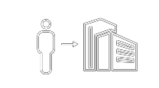
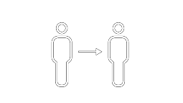
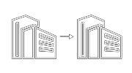
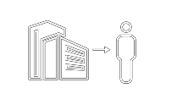


Same Day ACH
Greater payment flexibility: With 70 different consumer and business options,
Same Day ACH will greatly enhance payment processing options for clients.
E V A L U A T I N G A N D R E D U C I N G R I S K I N T H E P A Y M E N T E C O S Y S T E M
Consumer to Business
Bill pay
eCommerce
POS check conversion
Merchant debit
Collections
Consumer to Consumer
Person to person
Account to account
Business to Business
Trading partner payments
Due-date and invoice payments
Business to Consumer
Payroll
Insurance
Refunds
NACHA Implementation timeline
September 2016 – Phase 1
September 2017 – Phase 2
ACH credits and
debits
March 2018 – Phase 3
ACH credits and
₃ debits
Morning and
afternoon processing windows
5:00 p.m. receiver funds availability
ACH credits
2
afternoon processing windows
End of day receiver funds availability
Morning and afternoon processing windows
End of day receiver funds availability

Slide 4






Real Time Payments
J.P. Morgan is a board member of The Clearing House, leading the Real Time Payments Initiative to develop a set of industry level features and rules
Speed Amount Availability Messaging
Security
10
$25,000
24 / 7 / 365
ISO 20022
Credit Push
E V A L U A T I N G A N D R E D U C I N G R I S K I N T H E P A Y M E N T E C O S Y S T E M
Money available to payee within ten seconds.
Credit Transfers in
USD
Up to maximum
$25,000*
*25,000 limit is expected to rise over time
Instant payments available 24 x 7 x 365
Extensible messaging (ISO 20022) to support more sophisticated applications (e.g., bilateral messaging)
Sender initiates the transaction from own funded DDA
Timeline
J.P. Morgan is working with other banks through The Clearing House (TCH) to implement a
bank-led Real Time Payments infrastructure
Oct 2016
Q3 2017
Q1 2018
Q2 2018
onwards
TCH build and development
Limited B2B Pilots
Full launch rollout to participants
Increased bank participation

Slide 5

Fraud Mitigation Checklist
Checklist
ACH Debit Block or filters on all accounts
ACH positive pay
Universal Payment Identification Code (UPIC)
Virtual Reference Numbers
Account Balance Verification and Account Owner Verification via EWS
Manage Confirmation files at detail level
Minimize account opening to the extent possible
Daily recon on all accounts
Escalate suspicious e-mails
Rotate Treasury staff
Beware of 3 day holidays
E V A L U A T I N G A N D R E D U C I N G R I S K I N T H E P A Y M E N T E C O S Y S T E M

Slide 6
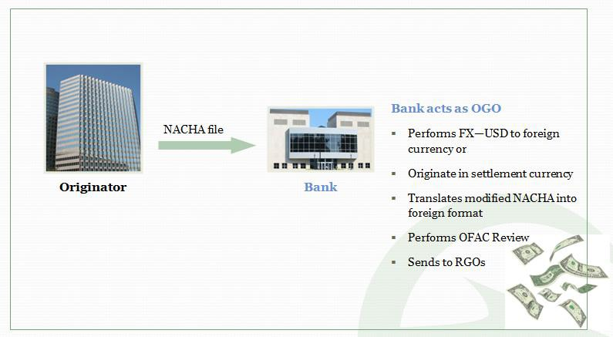
International ACH
How it works
2 0 1 7 N A C H A C O N F E R E N C E

Slide 7
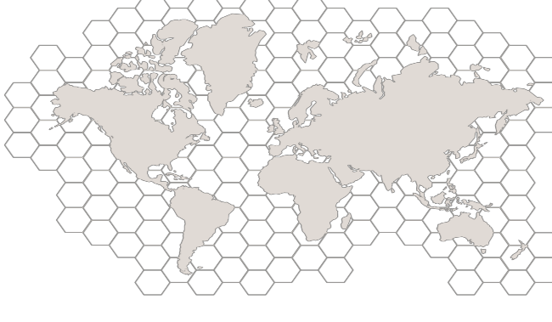


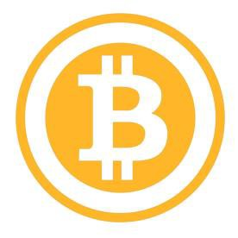
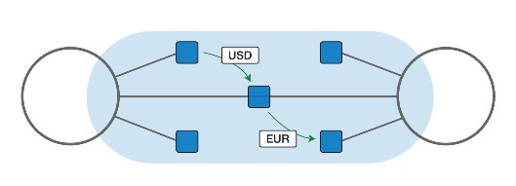

Disruptors
Blockchain crypto-processing is solving interoperability & data challenges across geographies
Benefits: Secure, Inexpensive, Fast Transfers in Any Currency
What it is:
▪ Utilizes a cloud-based ledger interconnecting the world’s disparate financial systems
▪ Enables international movement of funds while riding the rails of existing infrastructure
Ripple – One Example of Blockchain processing:
2 0 1 7 N A C H A C O N F E R E N C E
Sender provides payment details and a sending FI connects to Ripple to get and accept the FX rate
Receiver DDA
The receiving FI gets payment notification and processes payment
Sender DDA
Market Maker
A market maker holds the both the sender and receiver’s currencies and facilitates the transaction
Source: Ripple.com

Slide 8


Disruptors
Blockchain – a simple definition
A blockchain is a cryptographic, or encoded, ledger comprising a digital log of transactions shared across a public or private network*
What does the blockchain actually do?
What problems could it solve?
2 0 1 7 N A C H A C O N F E R E N C E
Allows for digitization of assets
Enables bilateral transactions between network participants
Distributes validation of transactions among multiple network participants
Leverages cryptographic techniques in managing assets and ownership on the ledger
Reduce the need for a trusted 3rd party
Eliminate centralized systemic risk
Prevent fraudulent activity
Improve inconsistent data quality & governance
11
*BLOCKCHAIN.info

Slide 9
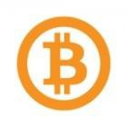



Disruptors
Bitcoin Blockchain versus Private Blockchains
Bitcoin Blockchain Private / Permissioned Blockchain
Example
Immutable Record
Immutable transaction database shared by all nodes participating within a network
Synchronized Data
All systems hold a local copy of the entire ledger and the network ensures that they are all
in sync
Participants /
Anyone
Permissioned / Known
Nodes on Protocol
Consensus Method
No Trust in System Proof of Work + Mining
Proof of Stake / Proof of Consensus
No Mining
Scale
7 transactions / second
10,000+ transactions / second
2 0 1 7 N A C H A C O N F E R E N C E
Assets
Bitcoin as token and native asset
Colored coin experiments
Potentially any asset
Fiat Currencies
LCs
Securities
Titles

Slide 10

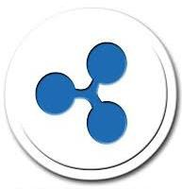
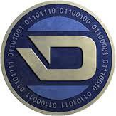

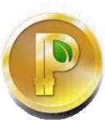



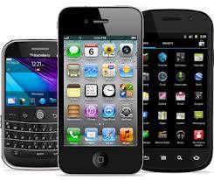








Disruptors
Customized payment networks will start to emerge to address specific payment needs
Emerging customizable cloud-based global payment networks
Innovation = Compliant Solutions that Leverage Today’s Technology
2 0 1 7 N A C H A C O N F E R E N C E
Local Alias-based payment networks that have solved geographic interoperability challenges

Slide 11

Disruptors
Payment Systems of Today: Apple Pay, Bitcoin, Venmo
Apple Pay
A wireless system that lets owners of IPhone 6 or 6 Plus pay for goods at retailers with payment terminals
$ $ $
2,500 Financial institutions now support Apple Pay as well as some 700,000 retail locations
In January 2015, Apple Pay accounted for TWO OUT OF THREE dollars spent via contactless payments
This year, COCA-COLA
MILLENNIALS are the most likely to use a smartphone to make a mobile payment
2 0 1 7 N A C H A C O N F E R E N C E
PLANS TO DEPLOY UP TO 100,000 VENDING MACHINES that will accept Apple Pay
14

Slide 12
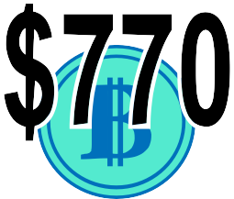
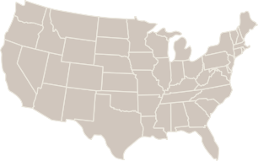





Disruptors
Bitcoin
A digital cryptocurrency that is simultaneously a cryptographic protocol and a virtual currency which gives
consumers a way to exchange money for free or a nominal fee
In 2014,
the price
of Bitcoin OPENED THE YEAR AT
This represents a DROP OF MORE THAN 50%
from the start of the year
-50%
$350
By mid-December, it was trading in the MID-$300 RANGE
111
THE UNITED STATES
61
CANADA
20
AUSTRALIA
20
THE UNITED KINGDOM
13
FINLAND
About 93% of the cryptocurrency’s users are MALE
A study found that most Bitcoin users were grouped in the states of California, Utah, Oregon, Washington, Nevada, New Hampshire and Vermont
MILLENNIALS ARE MORE LIKELY than any other age demographic to use digital currencies now and in the future – 13% use them today and 26 project using them by 2020
2 0 1 7 N A C H A C O N F E R E N C E
Source: New Jersey Institute of Technology
15

Slide 13
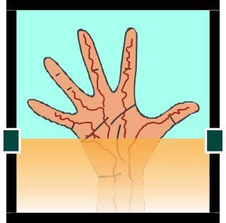


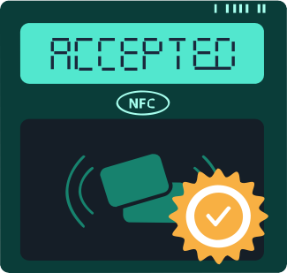
Disruptors
Future Forms of Payment
BIOMETRICS
APPLE WATCH
SOCIAL MEDIA
There is an idea to enable consumers to acquire products or discounts with social media actions IN LIEU OF CASH
VEIN PATTERN
Payment methods that rely on a palm’s unique vein pattern for
Available starting April 2015
The user DOUBLE TAPS the side button on the Apple Watch and holds it near an NFC to pay
authentication
Instragram users with at least 500 FOLLOWERS are eligible to pay at participating businesses by posting photos of the purchase
VOICE RECOGNITION
& FINGER VEIN
2 0 1 7 N A C H A C O N F E R E N C E
Barclays is introducing voice recognition for users of its telephone banking service as well as finger vein biometric scanners
The number of products available for this type of exchange increases in proportion with the number of followers
Source: New Jersey Institute of Technology

Slide 14
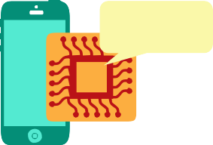
Disruptors
Safety
VIRTUAL CURRENCY
TAPPING TO PAY WITH A MOBILE PHONE
38%
A MOBILE APP
Percentage of American who are very concerned about potential fraud with each of the following forms of payment
48%
37%
?
It is possible to trace Bitcoin transactions although it may be DIFFICULT TO ASSOCIATE A TRANSACTION WITH A PARTICULAR INDIVIDUAL
THE CRYPTOGRAPHY
used in Bitcoin is military grade and the blockchain IS BELIEVED TO BE SECURE
Apple Pay Transactions are secured by means of
A uniquely generated code
Fingerprint authentication
192.168.2.1
Storing users credit card information directly on their iPhones IN A SPECIALLY DESIGNED CHIP AND THEN GENERATING PROXY
ACCOUNT numbers that it provides to retailers
2 0 1 7 N A C H A C O N F E R E N C E
In Venmo, ALL DATA IS SENT OVER A 256-BIT ENCRYPTED CONNECTION –
the same encryption method used to protect classified government information – and transactions are protected by the Federal Deposit Insurance Corporation
Source: New Jersey Institute of Technology

Slide 15


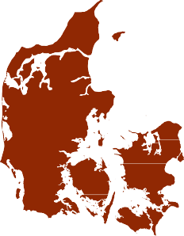
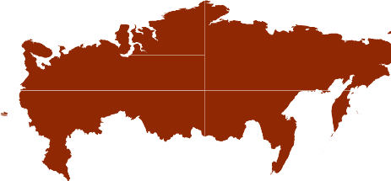

Disruptors
Regulations
BITCOIN transactions are extremely difficult to trace and so, they are considered IMMUNE TO TAXATION and currency control by governments
ANTI-MONEY LAUNDERING LAWS,
for example, ARE OBSOLETE when it comes to overseeing Bitcoin
These laws were originally written for banks before virtual currencies existed and are outdated
In March 2013, the AMERICAN INTERNAL REVENUE SERVICES DECLARED BITCOIN
‘PROPERTY’, for tax purposes, and not a currency in the traditional sense
In late 2013 and early 2014,
a number of nations took steps to ban or at least strictly limited virtual currencies
#1
THAILAND WAS FIRST
2 0 1 7 N A C H A C O N F E R E N C E
The Peoples Republic of China PROHIBITED
BANKS in the country from DEALING IN VIRTUAL CURRENCY
The Danish Financial Supervisory Authority has gone on record WARNING AGAINST
the use of these NON- GOVERNMENTAL
Russia’s central bank published an official warning stating that BITCOIN TRANSACTIONS ARE ILLEGAL IN RUSSIA

Slide 16
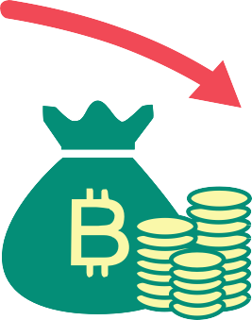
Disruptors
Money & Info Stolen
In February 2014, Mt. Gox, a major exchange that once handled over 70% of Bitcoin transactions, announced its LOSS OF 850,000 Bitcoins, valued at over $500 MILLION
In early2014, hackers discovered that DATA FROM STARBUCKS’ IOS USERS WAS NOT ENCRYPTED FOR SECURITY. The
company didn’t report any data stolen
2 0 1 7 N A C H A C O N F E R E N C E
Source: New Jersey Institute of Technology

Slide 17

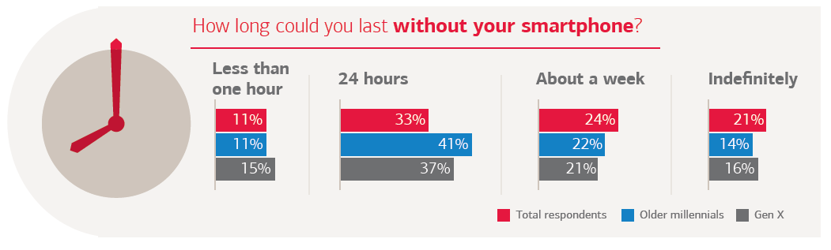
Disruptors
Mobile adoption
Half of the world’s population now has a mobile subscription. With an additional billion by 2020, taking the global penetration rate to 60%.¹
Now 50.3% of ecommerce website traffic comes through a mobile device²
In 2013, 95 million U.S. adults used mobile banking—27 million more than 2012³
By 2018, 63% of the mobile consumer population is forecasted to
be using mobile banking³
Mobile mindset⁴
Nearly half (44%) of Americans say they couldn’t make it a day without their mobile device. Older millennials (ages 25-
34) and Gen X (ages 35-49) are even more dependent on their smartphones.
How long could you last without your smartphone?
2 0 1 7 N A C H A C O N F E R E N C E
1. GMSA, The Mobile Economy 2015, www.gsmamobileeconomy.com; 2. Shopify; 3. Javelin Strategy & Research, MOBILE BANKING, TABLET AND SMARTPHONE FORECAST 2013- 2018: Smart Device Adoption Drives Mobile Banking Boom, March 2014; 4.Trends in Consumer Mobility Report, Bank of America, 2015
20

Slide 18
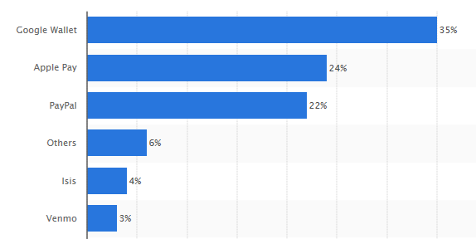


Disruptors
Adoption of Digital Wallets
Digital or “e-wallets” are the fastest growing payment type globally
They’re easy to use
Favored for digital content (books, music, games, etc.)
Young shoppers are driving this growth
Globally, Alipay and PayPal continue to dominate
U.S. most used digital wallets
as of January 2015
US Digital Wallet Payments¹
Transactional value and market share
2012 | $295B / 17%
2017e | $1,656B /41%
Now Android Pay
2 0 1 7 N A C H A C O N F E R E N C E
Now Soft Card
1. Worldpay, Your Global Guide to Alternative Payments Second Edition 2014

Slide 19
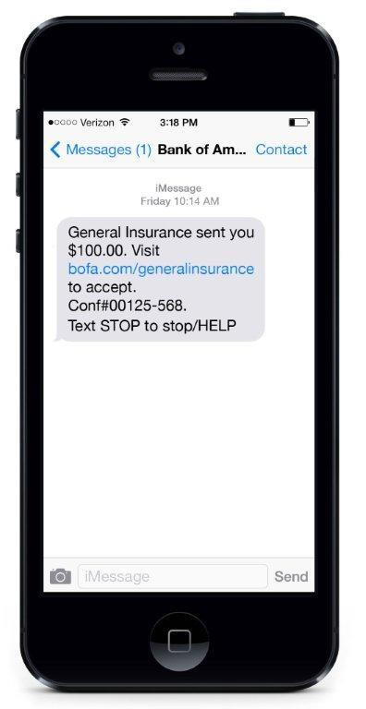




Disruptors – adoption of mobile money transfers
In the US, the number of mobile P2P users is expected to grow from 69 million adults in 2015 to 126 million (57% of all mobile device owners) by 2020.
Mobile P2P Transfers in
2015
Over a third of all consumers made
a mobile P2P transfer in 2015
Transfer of funds from one person’s bank account to another person’s bank account via online/mobile using an email address or mobile phone number
33%
Here’s why:
With mobile P2P you don't need the correct change, a paper check, or a nearby ATM
Transactions are also fast compared to the time it often takes to wait
for a check or bank transfer to clear
Mobile P2P payments remove some of the stigma of asking for money—users can request money remotely
2 0 1 7 N A C H A C O N F E R E N C E
Source: Javelin, Mobile P2P Payments in 2015: The Growth and Adoption of Mobile Money Transfers, 9/15

Slide 20
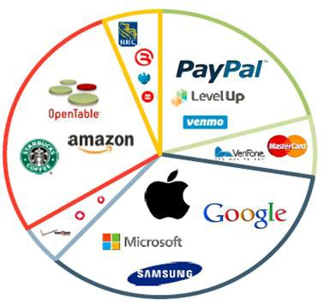
Regional Updates and Trends
Companies from Six Different Industries are Influencing the Mobile Payments Conversation
Financial Institutions
Bank of Beijing (China) Royal Bank of Canada (Canada)
BMO (Canada) HSBC (UK)
Central Bank of Nigeria (Nigeria)
Barclays (UK) ICICI Bank (India)
Reserve Bank of Zimbabwe (Zimbabwe)
Standard Bank (Kenya)
Payment Services (Mobile)
PayPal LevelUp Braintree Venmo Square Clinkle
UniteU Technologies Seamless Payments AB (Sweden)
Kopo Kopo (Kenya, Rwanda, Tanzania)
Retailers and Services
Payment Services (Traditional)
OpenTable Starbucks Amazon eBay Chipotle Whole Foods
Wireless (Network Providers)
Verizon Vodafone (India) Rogers (Canada) Teius (Canada)
China Mobile (China) Deutsche Telekom (Germany)
MasterCard SinglePoint VeriFone
Payment Services (Traditional)
2 0 1 7 N A C H A C O N F E R E N C E
Apple Google Microsoft Samsung
Xiaomi (China) Motorola Broadcom

Slide 21
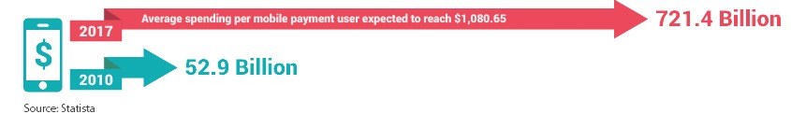
Regional Updates and Trends
Global Mobile Payment Transaction Volume
2 0 1 7 N A C H A C O N F E R E N C E
24

Slide 22
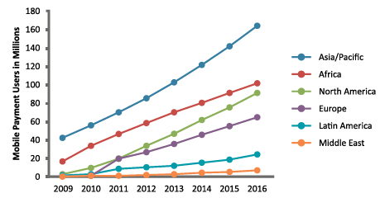
Regional Updates and Trends
Mobile Payment Users from 2009 to 2016 by Region
2 0 1 7 N A C H A C O N F E R E N C E
Source: PaymentEye
25

Slide 23
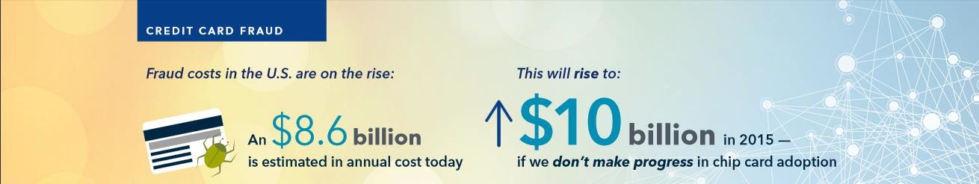
EMV
U.S. Credit Card Fraud
2 0 1 7 N A C H A C O N F E R E N C E
Source: Forbes.com
36

Slide 24
Anti-Money Laundering (AML)
Anti-money laundering (AML) is a term mainly used in the financial and legal industries to describe the legal controls that require financial institutions and other regulated entities to prevent or report money laundering activities.
AML guidelines came into prominence globally after the September 11, 2001 attacks and the subsequent enactment of the USA Patriot Act.
The long lasting implication of the enactment of the Patriot Act on broker-dealers, banks and other financial institutions is that they will be required to devote more resources than ever before to anti-money laundering efforts.
The Patriot Act requires anti-money laundering compliance programs, suspicious activity reporting, verification of new accounts, certain recordkeeping for “correspondent accounts” with foreign banks, special due diligence for correspondent and private banking accounts, and correspondent accounts with foreign shell banks.
2 0 1 7 N A C H A C O N F E R E N C E
Source: www.sifma.org

Slide 25
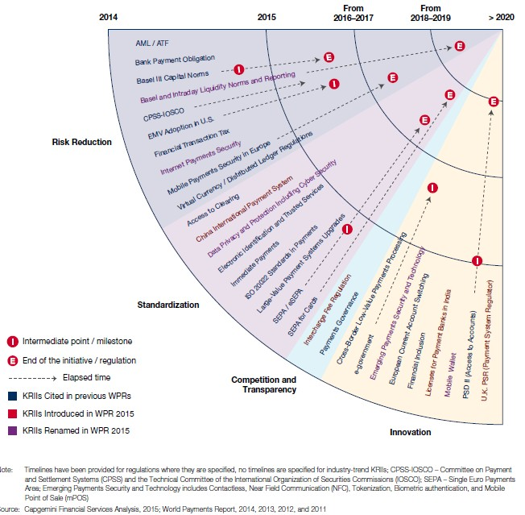
Regulations
Key Regulatory and Industry Initiatives Clustered by Regulators’ Primary Objectives, 2017
2 0 1 7 N A C H A C O N F E R E N C E

Slide 26
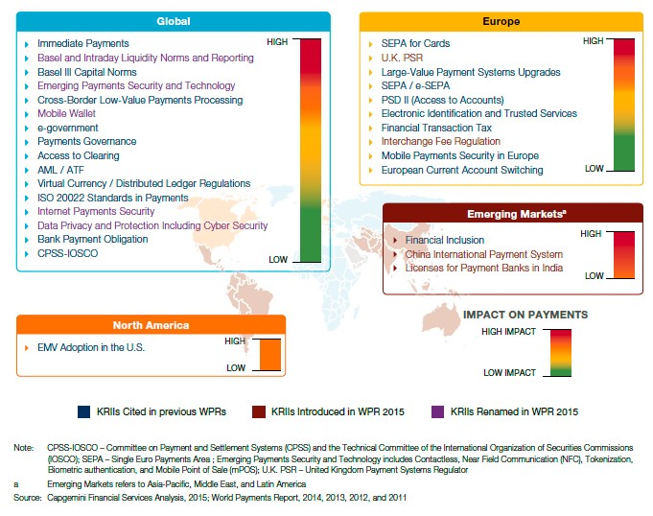
Regulations
Heat Map of Key Regulatory and Industry Initiatives, Global and Regional 2017
2 0 1 7 N A C H A C O N F E R E N C E

Slide 27
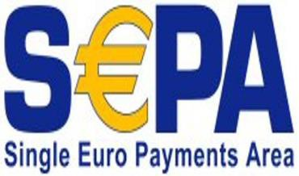

Corporate Perspective The SEPA
SEPA provided opportunity for XML conversion at ADP
Experience
_{ADP Canada Co.} • Lengthy conversion with Client readiness
William (Bill) Piggot
component
Promotes global standard for Banking and Business
Proved to be a great opportunity and learning experience
Highlighted need for standardization in Bank
adoption
Enabled efficiencies through expanded remittance detail
#Pay2014
8

Slide 28



Trends - Speed of Payment
End user demand for increased speed of payments is continuing to grow…
…spurring industry initiatives towards payments infrastructure improvement
75%
70%
59%
42%
of U.S. businesses expressed willingness to pay a fee for payments that have faster availability to the payee
of U.S. financial industry professional believe real-time ACH payments will become a reality within the next 1-2 years
of U.S. consumers expect both parties to receive instant confirmation of payment once a transaction is initiated
of U.S. consumers expect the recipient to be able to use the money immediately when making a payment
SOURCE: Federal Reserve Banks, ACI Worldwide, Celent
9
9

Slide 29
Trends – Type and Format
Global Payments Corporate Perspective
Millennial work force demographic growing rapidly
and willing to challenge status quo and adopt
new technologies
Faster and alternative payment options becoming increasingly available (PayPal , Apple Pay, Google Pay etc.)
Continuous market forces to drive down related interchange fees between Banks and merchants
Emerging contingent work options with ‘wages on
demand’ (eg. UBER, skilled trades etc.)
Global trend for mobile payment technologies
10

Slide 30
Summary
Global Payments Corporate Perspective
The XML standard serves the global commerce need
XML is the common business language for
Banking
Corporate entities can be stakeholder representatives on both Canada modernization and US NACHA working groups
Working with global Banking partners to adopt XML
Enabler to the business and our future direction in payment products
Focused on emerging trends and potential
disruptors in the payments industry
11

Slide 31
Faster Payments and impacts to Global Treasury Functions
Faster Payments set new liquidity expectations and deadlines that can span across weekends and even local bank holidays
Impact to decentralized Treasury groups with these new payment types
Similar to wires, no longer can solely forecast funding needs outside of local bank hours
Forecasting errors can lead to failed transactions if no overdraft lines put in place
Are there true value propositions to accept these that fit your corporate objectives?
US Faster Payments may not have similar impacts during initial phases
End of day availability with early cutoff times should not have much impact to overall volumes
Confidential
2

Slide 32
Corporates leveraging file standards to manage risks
Developing new payment methods combined with global market events putting increasing demands on Corporates to monitor and understand exposures to their banking counterparties
Centralized connectivity combined with file standards such as ISO/XML provide as much of a benefit for risk mitigation as other quantified operational objectives
Creates means to exit relationships quickly when necessary
ISO/XML standards enable Corporates to implement best local payment functionality without having to settle on existing partners that historically was due with concerns on time to connect and reconciliation efforts
Confidential
3

Slide 33
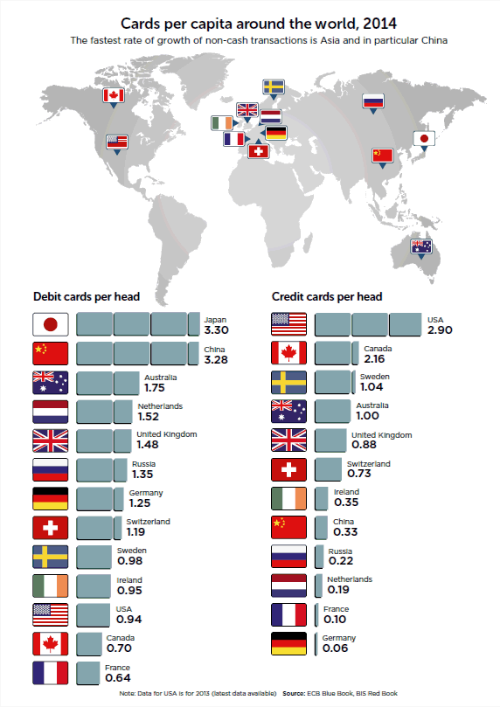
Cards
Remain
Popular
Globally
Cards remain most popular method to buy online
Penetration of cards does not equate with usage
Japan
China
Netherlands
Cards are the dominant “pull” payment method
Copyright © 2010-2017 RPGC Group LLC
8
All rights reserved
Source – Payments UK - World Class Payments in the UK

Slide 34
US Payment
Trends
EMV,
increased
fraud, and
tokenization
issues
dominating
the conversation
– Expected
fraud migration to
e‐Commerce
Spike
Class
Durbin
in chargebacks due
to EMV
action lawsuit
Amendment and
interchange
are back
on the
agenda
Apple Pay
and other
“fill the
blank” Pay
getting a lot
of media
attention
_{b}Co_{u}pyr_{t}ight © 2_{j}01_{u}0-20_{s}17 _{t}RPGC G_{l}rou_{u}p LL_{k}C
ewarm
10
All rights reserved

Slide 35
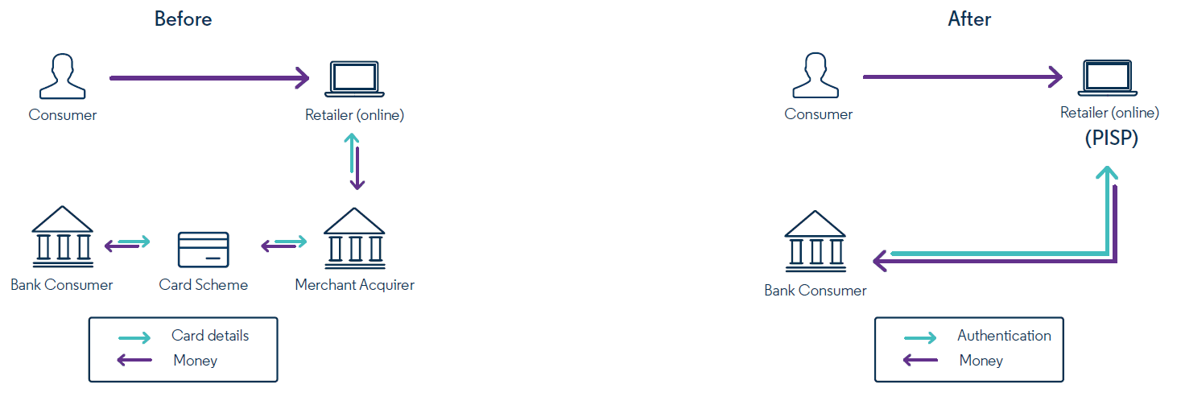
PSD2 Direct
Access to
Funds
Direct access to bank accounts without
intermediaries
Merchants become Payment Initiation Service Providers (PISPs)
Banks becomes an Account Servicing Payment Service Provider (ASPSP)
Service to be called Access to Accounts (XS2A)
Banks to develop and expose Application Programmatic Interfaces (APIs)
– APIs defined by the European Banking | Authority | (EBA)
– No sharing of bank login credentials | to AISP
Copyright © 2010-2017 RPGC Group LLC All rights reserved
13
Source – Evry – PSD2 Strategic opportunities beyond compliance

Slide 36
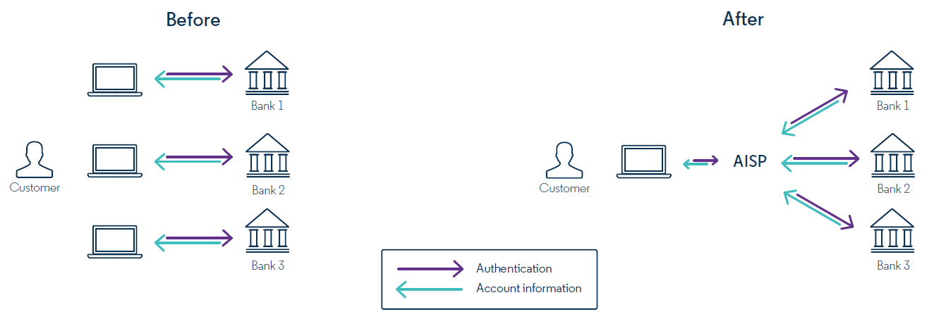
PSD2
Creating
New Services
Allow
creation of Account Information
Service
Providers (AISP)
– AISP will consolidate information from ASPSP (i.e. banks) in a manner similar the US
multiple to Mint in
– Expected to create new products and services through
a better understanding of consolidated data
AISP will gain access to bank data using ASPSP’ APIs
– No sharing of bank login credentials to AISP
Copyright © 2010-2017 RPGC Group LLC
14
Source – Evry – PSD2 Strategic opportunities beyond compliance
All rights reserved

Slide 37
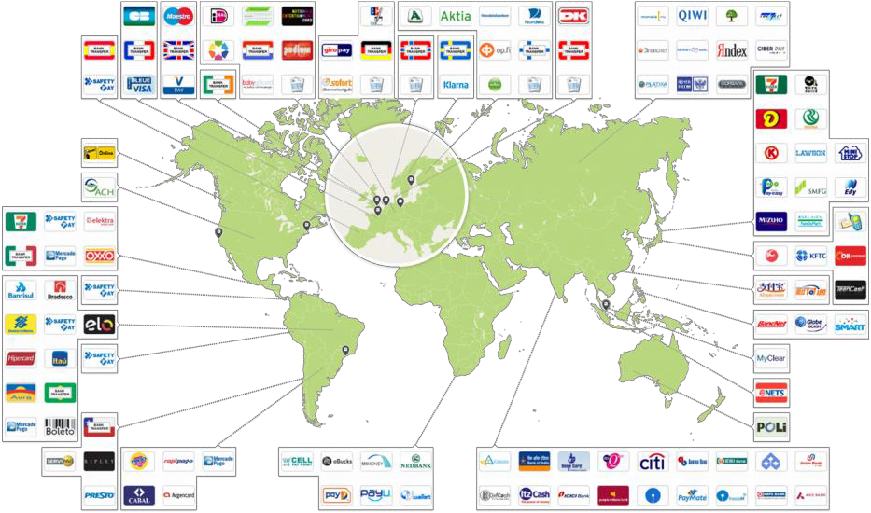
Implementing
Global
Payments
Copyright © 2010-2017 RPGC Group LLC All rights reserved
16
Source – Adyen

